Slide 1
ONLINE LEARNING SYSTEM

Slide 2
Under the guidance of
Prof .P.CHENNA REDDY M .Tech, Ph.D.
Project Members:
G. Sai Hemanth Kumar
Todime Deepa
Kommoji Sunitha

Slide 3
Contents
1. Introduction
2. Why Online Learning System?
3. What is Online Learning System?
4. Conclusion
5. References

Slide 4
INTRODUCTION
“Learning Management System” is a software that is designed specifically to create, distribute, and manage the delivery of educational content.
Existing Learning Management Systems (LMS) include:
Canvas Moodle
“Online Learning System” is a part of Learning Management System.

Slide 5
Why Online Learning System?
1. Existing Learning Management Systems include many features to which users may not want to pay attention.
2. Online Learning System simplifies the existing learning platforms by providing necessary and effective features.
3. Cost saving is also a major factor for building this system. The more features you include, the more it costs.

Slide 6
Why Online Learning System?
4. We cannot find best discussion boards in other learning platforms.
5. Online Learning System includes best discussion boards where users can share their views and pose questions.
6. Easy distribution of course content (just as easy as sending an email) is another advantage of this System.

Slide 7
What is Online Learning System?
Online Learning System includes an option to create and edit courses, upload files related to courses, display the courses created.
A course consists of modules, topics, descriptions, and instructor details.
Enrollment details of users such as Contact number, Name, Email, and Courses registered are displayed.

Slide 8
What is Online Learning System?
Flow of actions
Register
Create Course
Edit Course
End
Display Courses
Upload Files

Slide 9
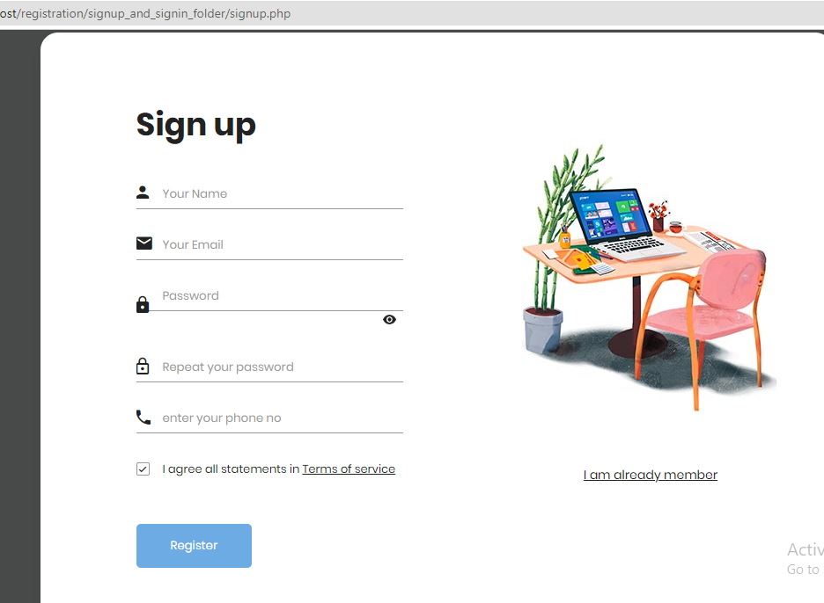
Sign Up process
Sign up process
Includes registering
User details such as
Name, Email,
Password and
Contact Number.

Slide 10
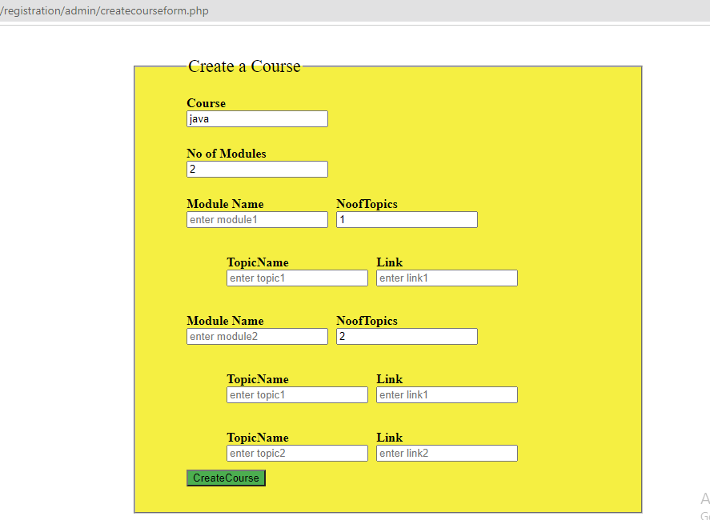
Creating Courses
Creating a course
Includes entering
Course name, no of
Modules, module
Name, no of topics,
Topic name.

Slide 11
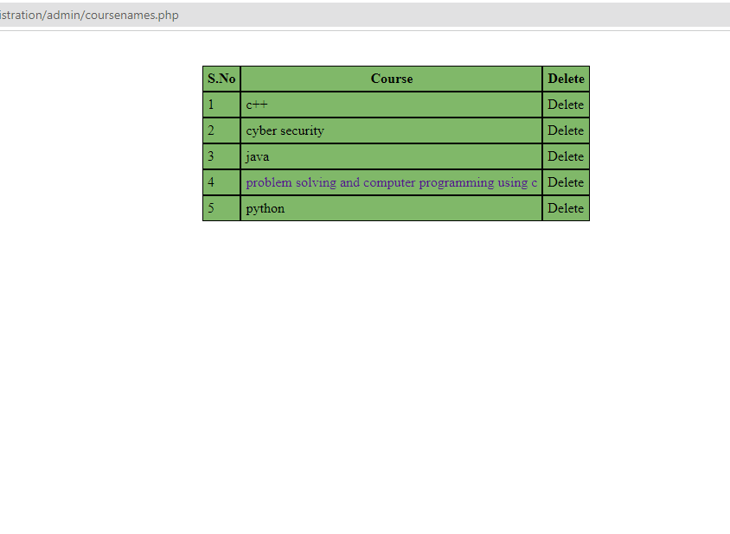
Display course names
It displays Courses
created

Slide 12
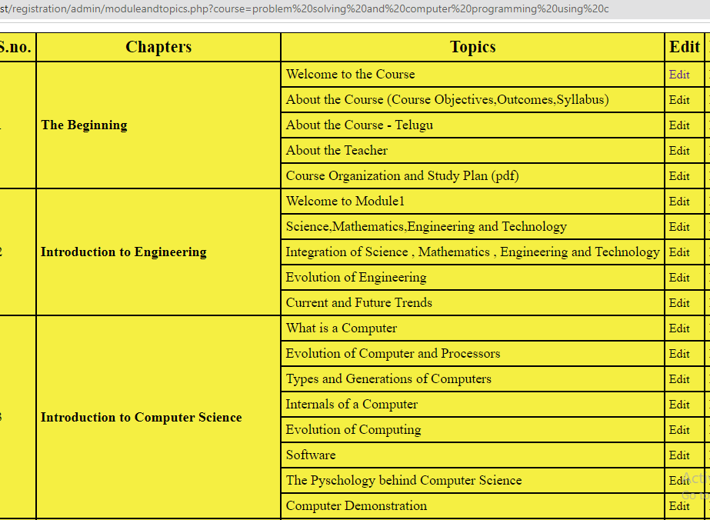
Displaying Course Details
Displaying course
Details (Modules,
topics).

